Slide 1
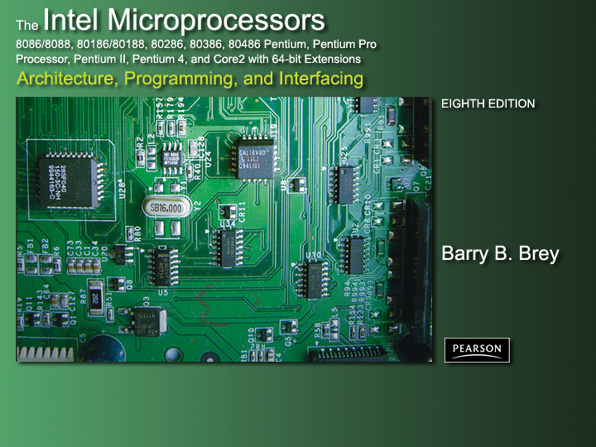
Chapter 13: Direct Memory Access and DMA-Controlled I/O

Slide 2
Introduction
The DMA I/O technique provides direct access to the memory while the microprocessor is temporarily disabled.
This chapter also explains the operation of disk memory systems and video systems that are often DMA-processed.
Disk memory includes floppy, fixed, and optical disk storage. Video systems include digital and analog monitors.

Slide 3
Chapter Objectives
Upon completion of this chapter, you will be able to:
Describe a DMA transfer.
Explain the operation of the HOLD and HLDA direct memory access control signals.
Explain the function of the 8237 DMA controller when used for DMA transfers.
Program the 8237 to accomplish DMA transfers.

Slide 4
Chapter Objectives
(cont.)
Upon completion of this chapter, you will be able to:
Describe the disk standards found in
personal computer systems.
Describe the various video interface
standards found in the personal computer.

Slide 5
13–1 BASIC DMA OPERATION
Two control signals are used to request and acknowledge a direct memory access (DMA) transfer in the microprocessor-based system.
  the HOLD pin is an input used to request a
  DMA action
  the HLDA pin is an output that acknowledges
  the DMA action
Figure 13–1 shows the timing that is typically found on these two DMA control pins.

Slide 6
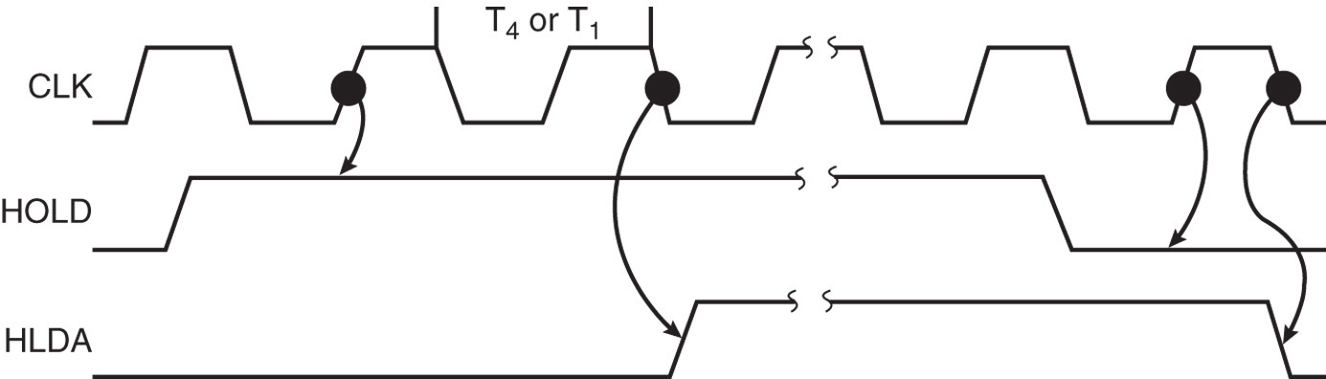
Figure 13–1 HOLD and HLDA timing for the microprocessor.
  HOLD is sampled in any clocking cycle
  when the processor recognizes the hold, it stops executing software and enters hold cycles
  HOLD input has higher priority than INTR or NMI
  the only microprocessor pin that has a higher priority than a HOLD is the RESET pin

Slide 7
HLDA becomes active to indicate the processor has placed its buses at high-impedance state.
  as can be seen in the timing diagram, there are
  a few clock cycles between the time that HOLD changes and until HLDA changes
HLDA output is a signal to the requesting device that the processor has relinquished control of its memory and I/O space.
  one could call HOLD input a DMA request
  input and HLDA output a DMA grant signal

Slide 8
Basic DMA Definitions
Direct memory accesses normally occur between an I/O device and memory without the use of the microprocessor.
  a DMA read transfers data from the memory
  to the I/O device
  A DMA write transfers data from an I/O device
  to memory
Memory & I/O are controlled simultaneously.
  which is why the system contains separate memory and I/O control signals

Slide 9
A DMA read causes the MRDC and IOWC signals to activate simultaneously.
  transferring data from memory to the I/O device
A DMA write causes the MWTC and IORC signals to both activate.
8086/8088 require a controller or circuit such as shown in Fig 13–2 for control bus signal generation.
The DMA controller provides memory with its address, and controller signal (DACK) selects the I/O device during the transfer.

Slide 10
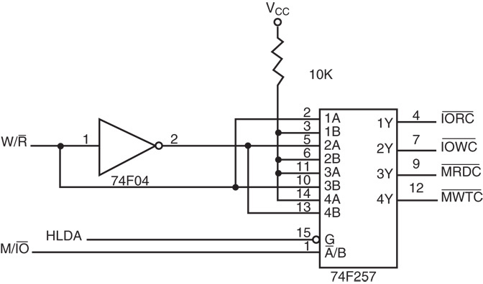
Figure 13–2 A circuit that generates system control signals in a DMA environment.

Slide 11
Data transfer speed is determined by speed of the memory device or a DMA controller.
  if memory speed is 50 ns, DMA transfers occur
  at rates up to 1/50 ns or 20 M bytes per second
  if the DMA controller functions at a maximum
  rate of 15 MHz with 50 ns memory, maximum transfer rate is 15 MHz because the DMA controller is slower than the memory
In many cases, the DMA controller slows the speed of the system when transfers occur.

Slide 12
The switch to serial data transfers in modern systems has made DMA is less important.
The serial PCI Express bus transfers data at rates exceeding DMA transfers.
The SATA (serial ATA) interface for disk drives uses serial transfers at the rate of 300 Mbps
  and has replaced DMA transfers for hard disks
Serial transfers on main-boards between components using can approach 20 Gbps
for the PCI Express connection.

Slide 13
13–2 THE 8237 DMA CONTROLLER
The 8237 supplies memory & I/O with control signals and memory address information during the DMA transfer.
  actually a special-purpose microprocessor
  whose job is high-speed data transfer between memory and I/O
Figure 13–3 shows the pin-out and block diagram of the 8237 programmable DMA controller.

Slide 14
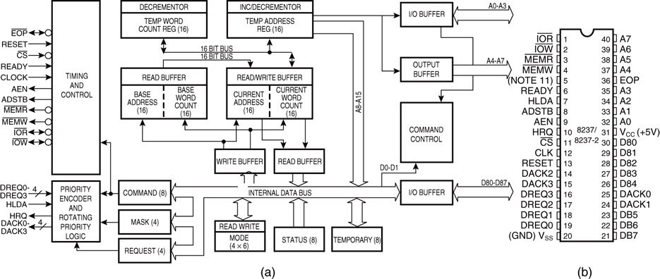
Figure 13–3 The 8237A-5 programmable DMA controller. (a) Block diagram and (b) pin-out. (Courtesy of Intel Corporation.)

Slide 15
8237 is not a discrete component in modern microprocessor-based systems.
  it appears within many system controller chip sets
8237 is a four-channel device compatible
with 8086/8088, adequate for small systems.
  expandable to any number of DMA channel inputs
8237 is capable of DMA transfers at rates up to 1.6M bytes per second.
  each channel is capable of addressing a full
  64K-byte section of memory and transfer up to 64K bytes with a single programming

Slide 16
8237 Pin Definitions
CLK
Clock input is connected to the system clock signal as long as that signal is 5 MHz or less.
  in the 8086/8088 system, the clock must be inverted for the proper operation of the 8237

Slide 17
8237 Pin Definitions
CS
Chip select enables 8237 for programming.
The CS pin is normally connected to the output of a decoder.
The decoder does not use the 8086/8088 control signal IO/M(M/IO) because it
contains the new memory and I/O control signals (MEMR, MEMW, IOR and IOW).

Slide 18
8237 Pin Definitions
RESET
The reset pin clears the command, status, request, and temporary registers.
It also clears the first/last flip-flop and sets
the mask register.
  this input primes the 8237 so it is disabled
  until programmed otherwise

Slide 19
8237 Pin Definitions
READY
A logic 0 on the ready input causes the
8237 to enter wait states for slower
memory components.
HLDA
A hold acknowledge signals 8237 that the microprocessor has relinquished control of
the address, data, and control buses.

Slide 20
8237 Pin Definitions
DREQ₀–DREQ₃
DMA request inputs are used to request a transfer for each of the four DMA channels.
  the polarity of these inputs is programmable, so
  they are either active-high or active-low inputs
DB₀–DB₇
Data bus pins are connected to the processor data bus connections and used during the programming of the DMA controller.

Slide 21
8237 Pin Definitions
IOR
I/O read is a bidirectional pin used during programming and during a DMA write cycle.
IOW
I/O write is a bidirectional pin used during programming and during a DMA read cycle.

Slide 22
8237 Pin Definitions
EOP
End-of-process is a bidirectional signal
used as an input to terminate a DMA
process or as an output to signal the
end of the DMA transfer.
  often used to interrupt a DMA transfer at
  the end of a DMA cycle

Slide 23
8237 Pin Definitions
A₀–A₃
These address pins select an internal
register during programming and provide
part of the DMA transfer address during a DMA action.
  address pins are outputs that provide part of
  the DMA transfer address during a DMA action

Slide 24
8237 Pin Definitions
HRQ
Hold request is an output that connects to
the HOLD input of the microprocessor in
order to request a DMA transfer.

Slide 25
8237 Pin Definitions
DACK₀–DACK₃
DMA channel acknowledge outputs acknowledge a channel DMA request.
These outputs are programmable as either active-high or active-low signals.
  DACK outputs are often used to select the
  DMA- controlled I/O device during the DMA transfer.

Slide 26
8237 Pin Definitions
AEN
Address enable signal enables the DMA address latch connected to the DB₇–DB₀
pins on the 8237.
  also used to disable any buffers in the
  system connected to the microprocessor

Slide 27
8237 Pin Definitions
ADSTB
Address strobe functions as ALE, except
it is used by the DMA controller to latch
address bits A₁₅–A₈ during the DMA transfer.
MEMR
Memory read is an output that causes memory to read data during a DMA read cycle.

Slide 28
8237 Pin Definitions
MEMW
Memory write is an output that causes memory to write data during a DMA write cycle.

Slide 29
8237 Internal Registers
CAR
The current address register holds a 16-bit memory address used for the DMA transfer.
  each channel has its own current address
  register for this purpose
When a byte of data is transferred during a DMA operation, CAR is either incremented
or decremented.
  depending on how it is programmed

Slide 30
8237 Internal Registers
CWCR
The current word count register programs
a channel for the number of bytes (up to 64K) transferred during a DMA action.
The number loaded into this register is one less than the number of bytes transferred.
  for example, if a 10 is loaded to CWCR, then
  11 bytes are transferred during the DMA action

Slide 31
8237 Internal Registers
BA and BWC
The base address (BA) and base word count (BWC) registers are used when
auto-initialization is selected for a channel.
In auto-initialization mode, these registers
are used to reload the CAR and CWCR
after the DMA action is completed.
  allows the same count and address to be used
  to transfer data from the same memory area

Slide 32
8237 Internal Registers
CR
The command register programs the operation of the 8237 DMA controller.
The register uses bit position 0 to select the memory-to-memory DMA transfer mode.
  memory-to-memory DMA transfers use DMA channel 0 to hold the source address
  DMA channel 1 holds the destination address
Similar to operation of a MOVSB instruction.

Slide 33
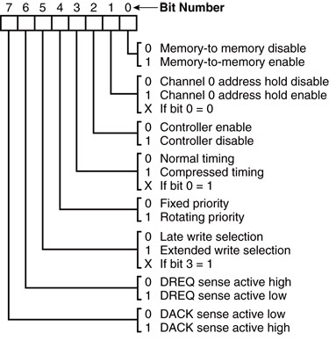
Figure 13–4 8237A-5 command register. (Courtesy of Intel Corporation.)

Slide 34
8237 Internal Registers
MR
The mode register programs the mode of operation for a channel.
Each channel has its own mode register as selected by bit positions 1 and 0.
  remaining bits of the mode register
  select operation, auto-initialization,
  increment/decrement, and mode for
  the channel

Slide 35
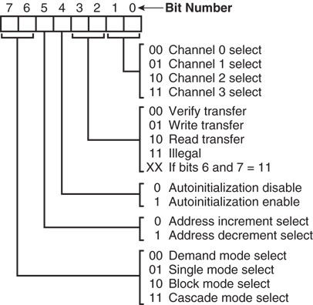
Figure 13–5 8237A-5 mode register. (Courtesy of Intel Corporation.)

Slide 36
8237 Internal Registers
BR
The bus request register is used to request
a DMA transfer via software.
  very useful in memory-to-memory transfers,
  where an external signal is not available to
  begin the DMA transfer

Slide 37
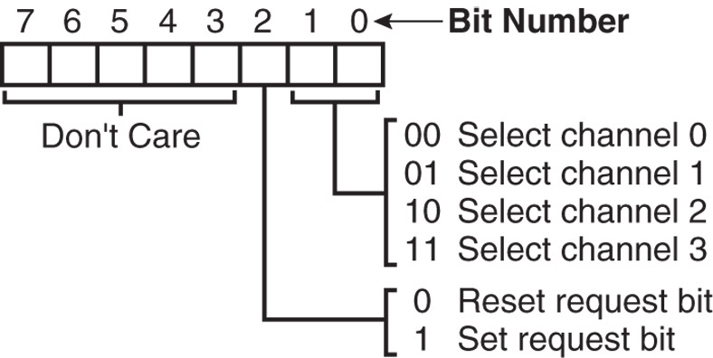
Figure 13–6 8237A-5 request register. (Courtesy of Intel Corporation.)

Slide 38
8237 Internal Registers
MRSR
The mask register set/reset sets or clears the channel mask.
  if the mask is set, the channel is disabled
  the RESET signal sets all channel masks
  to disable them

Slide 39
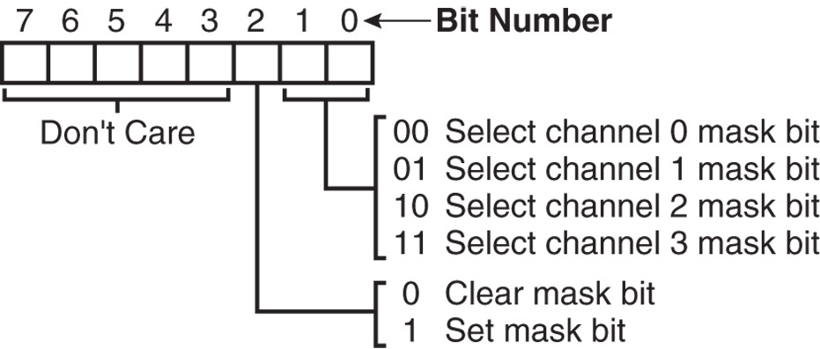
Figure 13–7 8237A-5 mask register set/reset mode. (Courtesy of Intel Corporation.)

Slide 40
8237 Internal Registers
MSR
The mask register clears or sets all of
the masks with one command instead of individual channels, as with the MRSR.

Slide 41
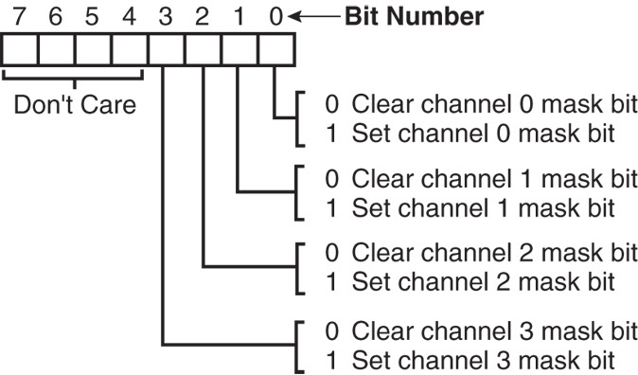
Figure 13–8 8237A-5 mask register. (Courtesy of Intel Corporation.)

Slide 42
8237 Internal Registers
SR
The status register shows status of each DMA channel. The TC bits indicate if the channel has reached its terminal count (transferred all its bytes).
When the terminal count is reached, the
DMA transfer is terminated for most modes
of operation.
  the request bits indicate whether the DREQ
  input for a given channel is active

Slide 43
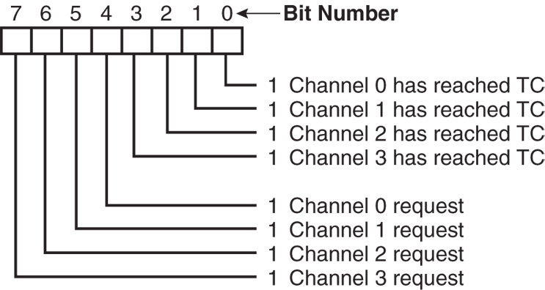
Figure 13–9 8237A-5 status register. (Courtesy of Intel Corporation.)

Slide 44
Software Commands
Three software commands are used to
control the operation of the 8237.
These commands do not have a binary bit pattern, as do various control registers
within the 8237.
  a simple output to the correct port number
  enables the software command
Fig 13–10 shows I/O port assignments that access all registers and the software commands.

Slide 45
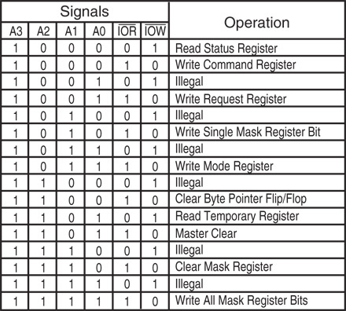
Figure 13–10 8237A-5 command and control port assignments. (Courtesy of Intel Corporation.)

Slide 46
8237 Software Commands
Master clear
Acts exactly the same as the RESET signal
to the 8237.
  as with the RESET signal, this command
  disables all channels
Clear mask register
Enables all four DMA channels.

Slide 47
8237 Software Commands
Clear the first/last flip-flop
Clears the first/last (F/L) flip-flop within 8237.
The F/L flip-flop selects which byte (low or high order) is read/written in the current address and current count registers.
  if F/L = 0, the low-order byte is selected
  if F/L = 1, the high-order byte is selected
Any read or write to the address or count register automatically toggles the F/L flip-flop.

Slide 48
Programming the Address and Count Registers
Figure 13–11 shows I/O port locations for programming the count and address
registers for each channel.
The state of the F/L flip-flop determines whether the LSB or MSB is programmed.
  if the state is unknown, count and address
  could be programmed incorrectly
It is important to disable the DMA channel before address and count are programmed.

Slide 49
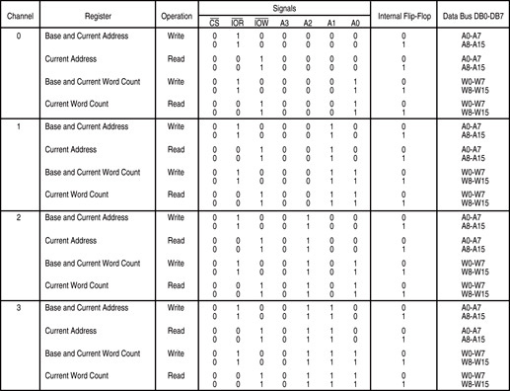
Figure 13–11 8237A-5 DMA channel I/O port addresses. (Courtesy of Intel Corporation.)

Slide 50
Four steps are required to program the 8237:
  (1) The F/L flip-flop is cleared using a clear F/L command
  (2) the channel is disabled
  (3) LSB & MSB of the address are programmed
  (4) LSB & MSB of the count are programmed
Once these four operations are performed, the channel is programmed and ready to use.
  additional programming is required to select
  the mode of operation before the channel is enabled and started

Slide 51
The 8237 Connected to the 80X86
The address enable (AEN) output of 8237 controls the output pins of the latches and outputs of the 74LS257 (E).
  during normal operation (AEN=0), latches
  A & C and the multiplexer (E) provide address
  bus bits A₁₉–A₁₆ and A₇–A₀
See Figure 13-12.

Slide 52
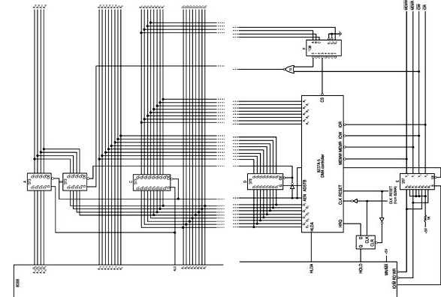
Figure 13–12 Complete 8088 minimum mode DMA system.

Slide 53
The multiplexer provides the system control signals as long as the 80X86 is in control of the system.
  during a DMA action (AEN=1), latches A & C
  are disabled along with the multiplexer (E)
  latches D and B now provide address bits
  A₁₉–A₁₆ and A₁₅–A₈
Address bus bits A₇–A₀ are provided directly by the 8237 and contain part of the DMA transfer address.
The DMA controller provides conntrol signals.

Slide 54
Memory-to-Memory Transfer with the 8237
Memory-to-memory transfer is much more powerful than the automatically repeated MOVSB instruction.
  most modern chip sets do not support the memory-to-memory feature
8237 requires only 2.0 µs per byte, which is over twice as fast as a software data transfer.
This is not true if an 80386, 80846, or Pentium is in use in the system.

Slide 55
Sample Memory-to-Memory DMA Transfer
Suppose contents of memory locations 10000H–13FFFH are to be transferred to locations 14000H–17FFFH.
  accomplished with a repeated string move instruction or with the DMA controller
Example 13–1 shows the software required
to initialize the 8237 and program latch B in Figure 13–12 for this DMA transfer.

Slide 56
Sample Memory Fill Using the 8237
To fill an area of memory with the same data, the channel 0 source register is programmed to point to the same address throughout the transfer.
  accomplished with the channel 0 hold mode
The controller copies the contents of this single memory location to an entire block
of memory addressed by channel 1.
This has many useful applications.

Slide 57
DMA-Processed Printer Interface
Fig 13–13 illustrates the hardware added
to Fig13–12 for a DMA-controlled printer interface.
  software to control this interface is simple as
  only the address of the data and number of characters to be printed are programmed
Once programmed, the channel is enabled, and the DMA action transfers a byte at a
time to the printer interface.
  each time a printer ACK signal is received

Slide 58
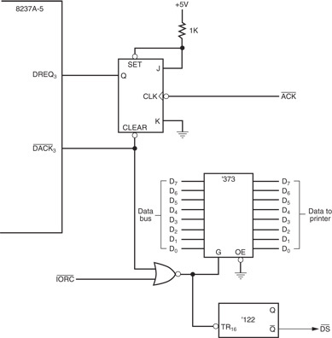
Figure 13–13 DMA-processed printer interface.

Slide 59
13–3 SHARED BUS OPERATION
Current computer systems have so many tasks to perform that some systems use more than one processor to accomplish the work.
  called a multiprocessing or a distributed system
  a system that performs more than one task
  is called a multitasking system
In systems that contain more than one processor, some method of control must
be developed and employed.

Slide 60
In a distributed, multiprocessing, multitasking environment, each microprocessor accesses two buses.
  (1) the local bus
  (2) the remote or shared bus
80286 uses the 82289 bus arbiter for shared bus operation.
  80386/80486 uses the 82389
The Pentium–Pentium 4 directly support a multiuser environment.

Slide 61
The local bus is connected to memory and I/O directly accessed by a single processor with no special protocol or access rules.
The remote (shared) bus contains memory and I/O that are accessed by any processor
in the system.

Slide 62
The bus master is the main microprocessor
in the PC.
  what we call the local bus in the PC is the
  shared bus in this illustration
The ISA bus is operated as a slave to the PC’s microprocessor.
  as well as any other devices attached to the shared bus
The PCI bus can operate as a slave or a master.

Slide 63
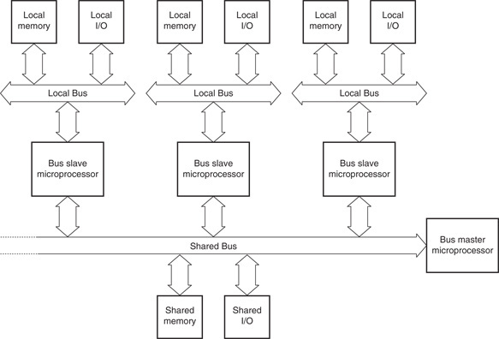
Figure 13–14 A block diagram illustrating the shared and local buses.

Slide 64
Types of Buses Defined
The local bus is resident to the processor.
  contains the resident or local memory and I/O
All microprocessors studied thus far in this
text are considered to be local bus systems.
  local memory and I/O are accessed by the microprocessor directly connected to them
A shared bus is one that is connected to all microprocessors in the system.
The shared bus is used to exchange data between microprocessors in the system.

Slide 65
Fig 13–15 shows an 8088 is connected as a remote bus master.
  bus master applies to any device that can
  control a bus containing memory and I/O
  the 8237 DMA controller is an example of
  a remote bus master
The 8088 has an interface to both a local, resident bus and the shared bus.
This allows 8088 to access memory & I/O.
  or, via the bus arbiter and buffers, the shared bus

Slide 66
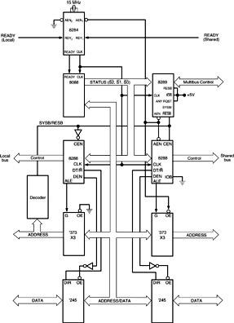
Figure 13–15 The 8088 operated in the remote mode, illustrating the local and shared bus connections.

Slide 67
The Bus Arbiter
The 8289 bus arbiter controls interface of a bus master to a shared bus.
Each bus master or microprocessor requires an arbiter for the interface to the shared bus.
  which Intel calls the Multibus
  and IBM calls the Micro Channel
Processors connected in this kind of system are often called parallel or distributed processors because they can execute software and perform tasks in parallel.

Slide 68
8289 Architecture
Fig 13–16 shows pin-outs and block diagram of the 8289 bus arbiter.
  the left side of the block diagram depicts the connections to the microprocessor
  the right side denotes the 8289 connection
  to the shared (remote) bus or Multibus
8289 controls the shared bus by causing the READY input to the microprocessor to become logic 0 (not ready) if access to the shared bus is denied.

Slide 69
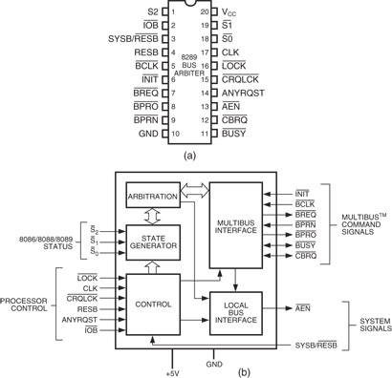
Figure 13–16 The 8289 pin-out and block diagram. (Courtesy of Intel Corporation.)
  8289 controls the shared bus by causing READY input to the microprocessor to become a logic 0 (not ready) if access to the shared bus is denied
  blocking occurs when another processor is accessing the shared bus

Slide 70
8289 Pin Definitions
AEN
The address enable output causes the bus drivers in a system to switch to their three-state, high-impedance state.

Slide 71
8289 Pin Definitions
ANYRQST
The any request input is a strapping option that prevents a lower- priority microprocessor from gaining access to the shared bus.
If tied to a logic 0, normal arbitration occurs and a lower priority microprocessor can gain access to the shared bus if CBRQ is also a logic 0.

Slide 72
8289 Pin Definitions
BCLK
The bus clock input synchronizes all shared-bus masters.
BPRN
The bus priority input allows the 8289 to acquire the shared bus on the next falling edge of the BCLK signal.

Slide 73
8289 Pin Definitions
BPRO
The bus priority output is a signal that is used to resolve priority in a system that contains multiple bus masters.
BREQ
The bus request output is used to request access to the shared bus.

Slide 74
8289 Pin Definitions
BUSY
The busy input/output indicates, as an
output, that an 8289 has acquired the
shared bus.
As an input, BUSY is used to detect that another 8289 has acquired the shared bus.

Slide 75
8289 Pin Definitions
CBRQ
The common bus request input/output is used when a lower priority microprocessor
is asking for the use of the shared bus.
As an output, CBRQ becomes logic 0 when the 8289 requests the shared bus and
remains low until the 8289 obtains access
to the shared bus.

Slide 76
8289 Pin Definitions
CLK
The clock input is generated by the 8284A clock generator and provides the internal timing source to the 8289.
CRQLCK
The common request lock input prevents 8289 from surrendering the shared bus to
any 8289 in the system. This signal functions in conjunction with the CBRQ pin.

Slide 77
8289 Pin Definitions
CLK
The initialization input resets 8289
  normally connected to the system RESET signal
IOB
The I/O bus input selects whether 8289 operates in a shared-bus system (if selected by RESB) with I/O (IOB=0) or with memory and I/O (IOB=1).

Slide 78
8289 Pin Definitions
RESB
The resident-bus input is a strapping connection allowing 8289 to operate in systems that have either a shared-bus or resident-bus system.
  if RESB is a logic 1, 8289 is configured as a shared-bus master
  if RESB is a logic 0, as a local-bus master
As a shared-bus master, access is requested through the SYSB/RESB input pin.

Slide 79
8289 Pin Definitions
LOCK
The lock input prevents the 8289 from allowing any other microprocessor from gaining access to the shared bus.
An 8086/8088 instruction that contains a LOCK prefix will prevent other processors from accessing the shared bus.

Slide 80
8289 Pin Definitions
S₀, S₁, and S₂
The status inputs initiate shared-bus requests and surrenders. These pins connect to the 8288 system bus controller status pins.
SYSB/RESB
The system bus/resident bus input selects the shared-bus system when placed at logic 1 or resident local bus when placed at logic 0.

Slide 81
General 8289 Operation
8289 can operate in three basic modes:
  (1) I/O peripheral-bus mode
  (2) resident-bus mode
  (3) single-bus mode
In the I/O peripheral bus mode, all local bus devices are treated as I/O, including memory.
  and are accessed by all instructions
All memory references access the shared bus and all I/O access the resident-local bus.

Slide 82
System Illustrating Single-Bus and Resident-Bus Connections
Single-bus operation interfaces a processor
to a shared bus with both I/O and memory resources shared by other processors.
Fig 13–17 illustrates three 8088 processors, each connected to a shared bus.
Two of the three microprocessors operate in the resident-bus mode, while the third operates in the single-bus mode.

Slide 83
Microprocessor A, in Figure 13–17, operates in the single-bus mode and has no local bus.
  this processor accesses only shared memory & I/O space and is often referred to as the system-bus master because it is responsible for coordinating the main memory and I/O tasks
The remaining two (B and C) are connected
in resident-bus mode
  which allows them access to both the shared
  bus and their own local buses

Slide 84
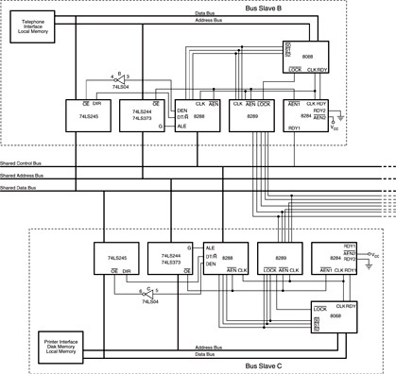
Figure 13–17 Three 8088 microprocessors that share a common bus system. Microprocessor A is the bus master in control of the shared memory and CRT terminal. Microprocessor B is a bus slave controlling its local telephone interface and memory. Microprocessor C is also a slave that controls a printer, disk memory system, and local memory.

Slide 85
Bus master (A) allows the user to operate with a video terminal that allows execution of programs and generally controls the system.
Microprocessor B handles all telephone communications and passes this information to the shared memory in blocks.
Processor C is used as a print spooler. Its only task is to print data on the printer.
  when the bus master requires printed output,
  it transfers the task to microprocessor C
These tasks all execute simultaneously.

Slide 86
There is no limit to the number of processors connected to a system or the number of tasks performed simultaneously using this technique.
  the only limit is that introduced by the system design and the designer’s ingenuity
Lawrence Livermore Labs in California has
a system that contains 4096 Pentium microprocessors.

Slide 87
13–4 DISK MEMORY SYSTEMS
Disk memory is used to store long-term data.
Many types of disk storage systems are available and they use magnetic media.
  except optical disk memory that stores data
  on a plastic disk
Optical disk memory is either:
  CD-ROM (compact disk/read only memory)
  which read, but never written
  WORM (write once/read mostly), read most of
  the time, but can be written once by a laser

Slide 88
Optical disk memory that can be read and written many times is becoming available.
  there is still a limitation on the number of write operations allowed
The latest optical disk technology is called DVD (digital-versatile disk).
  also available in high-resolution versions for
  video and data storage as Blu-ray (50G) or
  HD-DVD (30G)

Slide 89
Floppy Disk Memory
The floppy, or flexible disk was once the most common and basic form of disk memory.
  the floppy is beginning to vanish and may disappear shortly in favor of the USB pen drive
Floppy disk magnetic recording media have been made available in three sizes:
  8″ standard
  5¹/₄″ mini-floppy
  3¹/₂″ micro-floppy.

Slide 90
All disks have several things in common.
They are all organized so that data are stored in tracks and sectors.
  a track is a concentric ring of data stored on
  the surface of a disk
  a sector is a common subdivision of a track
  designed to hold a reasonable amount of data
In many systems, a sector holds either 512
or 1024 bytes of data.
  size of a sector can vary from 128 bytes to the length of one entire track

Slide 91
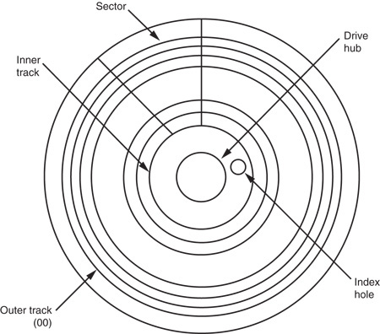
Figure 13–18 The format of a 5¹/₄″ mini-floppy disk.
  the index hole is so the system can find the start of a track and first sector (00)
  tracks are numbered from track 00, the outermost track, toward the center
  sectors are often numbered from sector 00 on the outermost track

Slide 92
The 5 ¹/₄″ Mini-floppy Disk
The 5¹/₄″ floppy is very difficult to find and is used only with older microcomputer systems.
The floppy disk is rotated at 300 RPM inside its semi-rigid plastic jacket.
  the head mechanism in a floppy drive makes physical contact with the surface of the disk,
  which causes wear and damage to the disk
Most mini-floppy disks are double-sided.
  data are written on the top & bottom surfaces

Slide 93
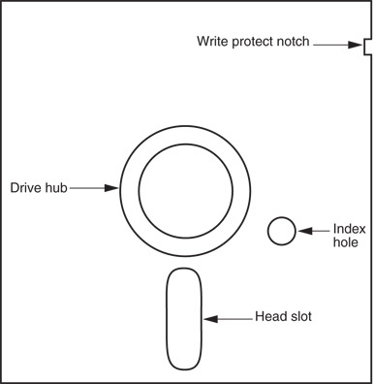
Figure 13–19 The 5¹/₄″ mini-floppy disk.
  a set of tracks called
  a cylinder consists
  of one top and one bottom track
  Cylinder 00 consists
  of the outermost top and bottom tracks

Slide 94
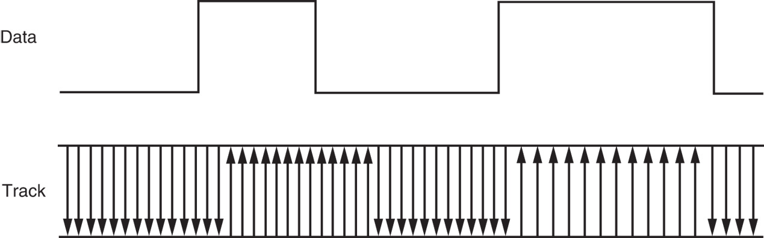
Figure 13–20 The non-return to zero (NRZ) recording technique.
  the magnetic recording technique used to store data on the surface of the disk is called non-return to zero (NRZ) recording
  with NRZ recording, magnetic flux placed on the surface of the disk never returns to zero
  arrows show the polarity of the magnetic field stored on the surface of the disk

Slide 95
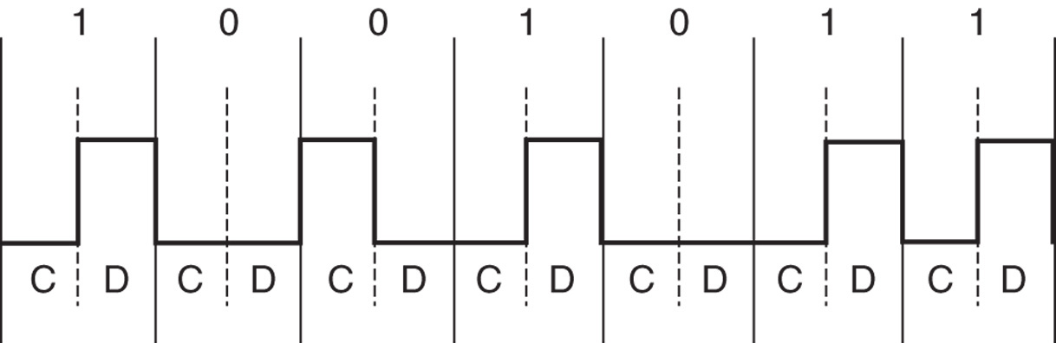
Figure 13–21 Modified frequency modulation (MFM) used with disk memory.
  data are stored in the form of MFM (modified frequency modulation) on modern floppy disks
  each bit time is 2.0 µs wide on a double-density disk
  data are recorded at the rate of 500,000 bits per second

Slide 96
The 3 ¹/₂″ Micro-Floppy Disk
A much improved version of the mini-floppy disk described earlier.
The micro-floppy is packaged in a rigid plastic jacket that will not bend easily.
  a much greater degree of protection to the disk
The head door remains closed until the disk is inserted into the drive.
  once in the drive, the mechanism slides open
  the door, exposing the surface of the disk to
  the read/write heads

Slide 97
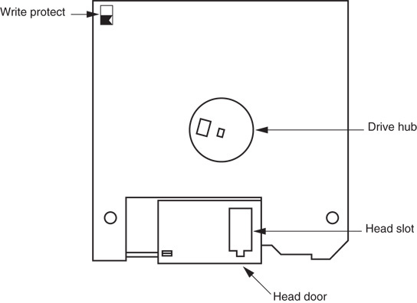
Figure 13–22 The 3¹/₂″ micro-floppy disk.

Slide 98
On the mini-floppy, a piece of tape was placed over a notch on the side of the
jacket to prevent writing.
  this plastic tape easily became dislodged
  inside disk drives, causing problems
The micro-floppy has an integrated plastic slide replacing the tape write-protection.
To write-protect (prevent writing) the micro-floppy disk, the plastic slide is moved to open the hole through the disk jacket.
  allows light to strike a sensor that inhibits writing

Slide 99
Pen Drives
Pen drives, or flash drives use flash memory to store data.
  a driver treats the pen drive as a floppy with
  tracks and sectors, though it really does not
The FAT system is used for the file structure.
  memory in this type of drive is serial memory
When connected to the USB bus, the OS recognizes it and allows data to be
transferred between it and the computer.

Slide 100
Hard Disk Memory
Hard disk memory has a much larger capacity than the floppy disk memory.
  often called a fixed disk because it is not removable like the floppy disk
A hard disk is also often called a rigid disk.
  the term Winchester drive is also used, but
  less commonly today
Common, low-cost (less than $1 per gigabyte) sizes are presently 20G bytes to 500G bytes.
  sizes approaching 1 T (tera) bytes are available

Slide 101
The hard disk memory uses a flying head to store and read data.
A flying head, which is very small and light, does not touch the surface of the disk.
  it flies above the surface on a film of air that is carried with the surface of the disk as it spins
The hard disk typically spins at 3000 to 15,000 RPM, many times faster than a floppy.
  higher rotational speed allows the head to fly
  just over the top of the surface of the disk
There is no wear on the hard disk’s surface.

Slide 102
Problems can arise because of flying heads.
  if power is interrupted or the drive is jarred, the head can crash onto the disk surface, which
  can damage the disk surface or the head
Some drive manufacturers have included a system to automatically park the head when power is interrupted.
  when the heads are parked, they are moved
  to a safe landing zone (unused track) when
  power is disconnected

Slide 103
Another difference between a floppy and a hard drive is the number of heads and disk surfaces.
  a floppy has two heads, one for the upper
  surface and one for the lower surface
  the hard drive has up to eight disk surfaces (four platters), with up to two heads per surface
Each time a new cylinder is obtained by moving the head assembly, 16 new tracks
are available under the heads.
See Figure 13–23.

Slide 104
Heads are moved from track to track by using either a stepper motor or a voice coil.
  the stepper motor is slow and noisy; moving the head assembly requires one step per cylinder
  the voice coil mechanism is quiet and quick; the heads can be moved many cylinders with one sweeping motion
Stepper-motor-type head positioning mechanisms can become misaligned
  while the voice coil mechanism corrects for
  any misalignment

Slide 105
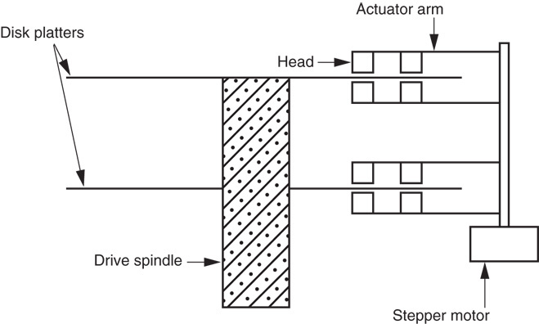
Figure 13–23 A hard disk drive that uses four heads per platter.

Slide 106
Hard drives often store information in sectors that are 512 bytes long.
Data are addressed in clusters of eight or more sectors, which contain 4096 bytes (or more) on most hard disk drives.
All hard drives use today RLL encoding.

Slide 107
RLL Storage
The term run-length limited (RLL) means the run of zeros (zeros in a row) is limited.
  a common RLL encoding scheme is RLL 2,7, which means the run of zeros is always between
  two and seven
An RLL drive often contains 27 tracks instead of the 18 found on the MFM drive.
Fig 13–24 is a comparison of MFM & RLL.
  besides holding more information, the RLL drive can be written and read at a higher rate

Slide 108
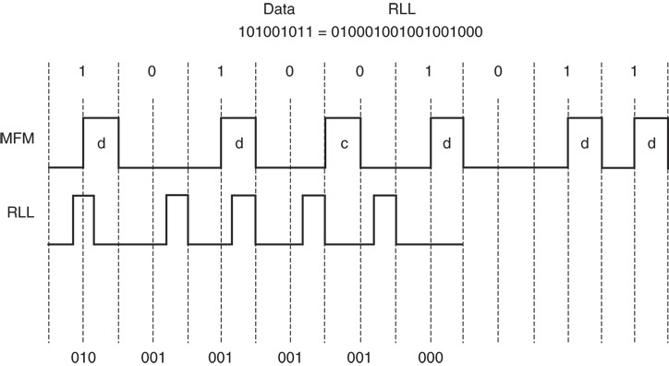
Figure 13–24 A comparison of MFM with RLL using data 101001011.

Slide 109
There are a number of disk drive interfaces in use today.
  the oldest is the ST-506 interface, which uses either MFM or RLL data
Newer standards are in use today.
  which include ESDI, SCSI, and IDE
The IDE system is becoming the standard hard disk memory interface.
The enhanced small disk interface (ESDI) system is capable of transferring data at
rates approaching 10M bytes per second.

Slide 110
ST-506 interface approaches 860K bytes/sec.
The small computer system interface (SCSI) allows up to seven different disk or other interfaces to be connected to the computer through same interface controller.
  SCSI is found in some PC-type computers and also in the Apple Macintosh system
An improved version, SCSI-II, has started to appear in some systems.
  in the future, this interface may be replaced
  with IDE in most applications

Slide 111
One of the most common systems is the integrated drive electronics (IDE) system.
  incorporates the disk controller in the drive and attaches to the host system through a small interface cable
IDE drives are found in newer IBM PS-2 systems and many clones.
  even Apple computer systems are starting
  to be found with IDE drives
The IDE interface is also capable of driving other I/O devices besides the hard disk.

Slide 112
IDE usually contains at least a 256K- to 8M-byte cache memory for disk data.
  the cache speeds disk transfers
Access times for an IDE drive are often less than 8 ms.
  access time for a floppy-disk is about 200 ms
IDE is also called ATA, an acronym for
AT attachment where “AT” means the Advanced Technology computer.

Slide 113
The latest is the serial ATA interface or SATA.
  this interface transfers serial data at 150 MBps
  (or 300 MBps for SATA2), faster than IDE
Not yet released is SATA3, which transfers data at a rate of 600 MBps.
The transfer rate is higher because the logic 1 level is no longer 5.0 V. It is now 0.5 V.
  which allows higher data transfer rates because
  it takes less time for the signal to rise to 0.5 V than to 5.0 V

Slide 114
Optical Disk Memory
Optical disk memory is commonly available
in two forms:
  CD-ROM (compact disk/read only memory)
  WORM (write once/read mostly)
CD-ROM is the lowest cost, but suffers from lack of speed.
  access times are typically 300 ms or longer
As systems develop and become more visually active, use of the CD-ROM drive
will become even more common.

Slide 115
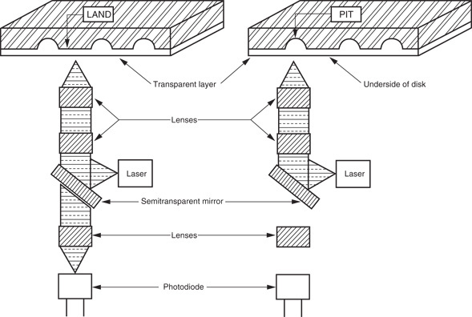
Figure 13–25 The optical CD-ROM memory system.

Slide 116
The WORM drive sees far more commercial application than the CD-ROM.
  application is very specialized due to its nature
WORM is normally used to form an audit trail of transactions spooled onto the WORM and retrieved only during an audit.
  one might call the WORM an archiving device
The advantage of the optical disk is durability.
About the only way to destroy data on an optical disk is to break it or deeply scar it.

Slide 117
The new versatile read/write CD-ROM, called a DVD, became available in the mid 1990’s.
New to this technology are the Blu-ray DVD from Sony Corporation and the HD-DVD
from Toshiba Corporation.
  Blu-ray DVD capacity is 50 GB; HD-DVD, 30 GB
The big change from older DVDs is a switch from a red laser to a blue laser.
  a blue laser has a higher frequency, which
  means it can read more information per second from the DVD, hence a high storage density

Slide 118
13–5 VIDEO DISPLAYS
Color display systems are available that accept information as a composite video
signal as TIL voltage level signals (0 or 5 V), and as analog signals (0–0.7 V).
  composite video displays are disappearing because the available resolution is too low
Early composite video displays were found with Commodore 64, Apple 2, and similar computer systems.

Slide 119
Video Signals
Fig 13–26 illustrates the signal sent to a composite video display.
These signals include video, sync pulses, sync pedestals, and a color burst.
  no audio signal is shown; one often doesn’t exist
Major disadvantages of the composite video display are the resolution and color limitations.
  composite video was designed to emulate television video so a home television could function as a video monitor

Slide 120
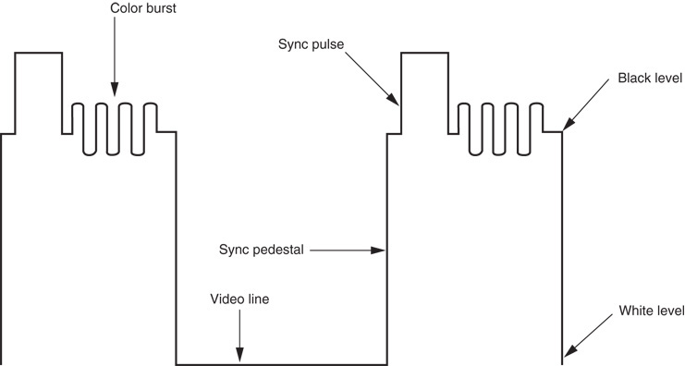
Figure 13–26 The composite video signal.

Slide 121
The TTL RGB Monitor
Available as either an analog or TTL monitor.
The RGB video TTL display can display a
total of 16 different colors.
TTL RGB is used in CGA (color graphics adapter) system found in older systems.
Figure 13–27 shows the connector found on
a TTL RGB or monochrome monitor.
  monochrome TTL monitors use the same
  9-pin connector as RGB TTL monitors

Slide 122
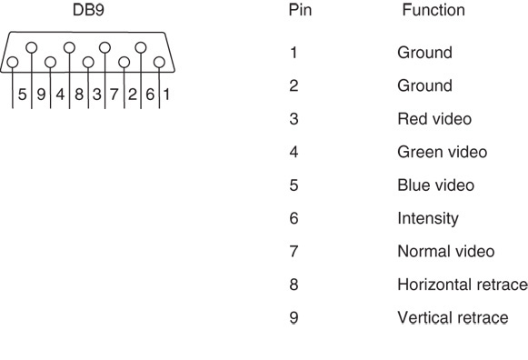
Figure 13–27 The 9-pin connector found on a TTL monitor.

Slide 123
To display more than 16 colors, an analog video display is required.
Because the video signals are analog signals instead of two-level TTL signals, they are at any voltage level between 0.0 V and 0.7 V, which allows an infinite number of colors.
  this is because an infinite number of voltage levels could be generated
Fig 13–28 shows the connector used for an analog RGB or analog monochrome monitor.

Slide 124
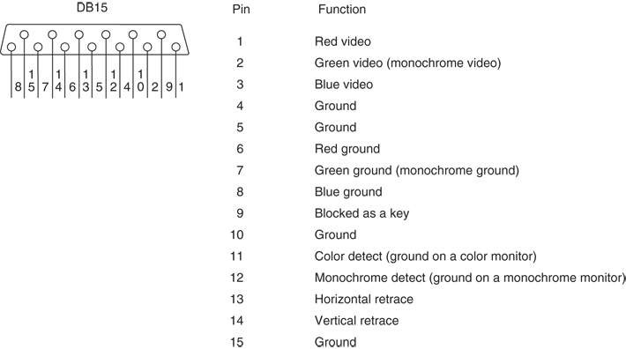
Figure 13–28 The 15-pin connector found on an analog monitor.

Slide 125
Another type of connector for analog RGB is called the DVI-D (digital visual interface).
  the -D is for digital, the most common of this type
Figure 13–29 illustrates the female connector found on newer monitors and video cards.
Also found on television and video equipment is the HDMI (high-definition multimedia interface) connector.
  eventually all video equipment will use the
  HDMI connector for its connection

Slide 126
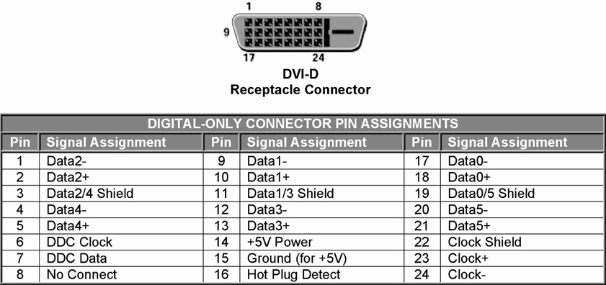
Figure 13–29 The DVI-D interface found on many newer monitors and video cards.

Slide 127
Most analog displays use digital-to-analog converter to generate color video voltage.
There are 256 different red video levels, 256 different green video levels, and 256 different blue video levels.
  this allows 256 × 256 × 256, or 16,777,216
  (16 M) colors to be displayed
Figure 13–30 illustrates the video generation circuit employed in many common video standards as used with an IBM PC.

Slide 128
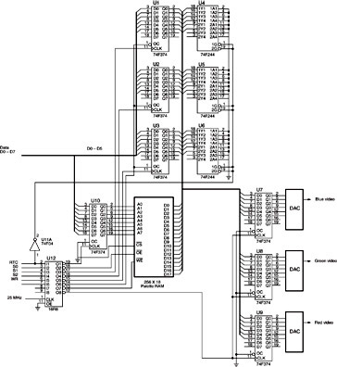
Figure 13–30 Generation of VGA video signals.

Slide 129
A high-speed palette SRAM is used to store 256 different 18-bit codes representing hues.
To select any of 256 colors, an 8-bit code stored in the computer’s video display RAM
is used to specify color of a picture element.
  if more colors are used, the code must be wider
  newer systems use larger palette SRAM to
  store up to 64K of different color codes
If color codes must be changed, it is done during retrace when RTC is a logic 1.
  preventing video noise from disrupting the image

Slide 130
Retrace occurs 70.1 times per second vertical and 31,500 times per second horizontal direction for a 640 × 480 display.
  used to move the electron beam to the upper
  left corner for vertical retrace and the left
  margin of the screen for horizontal retrace
The resolution of the display determines the memory required for the video interface card.
  640 × 480 bytes of memory (307,200) are required to store all of the pixels for the display

Slide 131
A 640 × 480 display has 480 video raster lines and 640 pixels per line.
  a raster line is the horizontal line of video information that is displayed on the monitor
  a pixel (picture element) is the smallest subdivision of this horizontal line
In order to generate 640 pixels across one line, it takes 40 ns × 640, or 25.6 µs.
A horizontal time of 31,500 Hz allows a horizontal line time of 1/31,500, or 31.746 µs.
  the difference between these two times is the retrace time allowed to the monitor

Slide 132
In the case of a VGA display (a 640 × 400 display), this is 449.358 lines.
  400 lines are used to display information
  the rest are lost during the retrace
Because 49.358 lines are lost, retrace time
is 49.358 × 31.766 µs, or 1568 µs.
During this time color palette SRAM is changed or the display memory is updated.
Fig 13–31 illustrates the video display, showing the video lines and retrace.

Slide 133
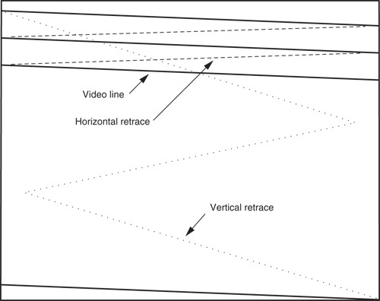
Figure 13–31 A video screen illustrating the raster lines and retrace.

Slide 134
800 × 600 SVGA (super VGA) display is ideal for a 14″ color monitor
1024 × 768 EVGA or XVGA (extended VGA) is ideal for a 21″ or 25″ monitor,
  an average home television receiver has
  a resolution of approximately 400 × 300
Disadvantage of the video display on is
the number of colors displayed at a time.
Additional colors allow the image to appear more realistically because subtle shadings are required for a true high-quality, lifelike image.

Slide 135
High-resolution displays use interlaced or non-interlaced scanning.
  non-interlaced is used in all except the highest standards
In the interlaced system, the displayed draws half the image first with all the odd scan lines.
  the other half is then drawn using even scan lines
This system is more complex
  and only more efficient because scanning frequencies are reduced by 50%

Slide 136
SUMMARY
The HOLD input is used to request a DMA action, and the HLDA output signals that the hold is in effect.
When a logic 1 is placed on the HOLD input, the micro-processor (1) stops executing the program; (2) places its address, data, and control bus at their high-impedance state; and (3) signals that the hold is in effect by placing a logic 1 on the HLDA pin.

Slide 137
SUMMARY
(cont.)
A DMA read operation transfers data from a memory location to an external I/O device.
A DMA write operation transfers data from an I/O device into the memory.
Also available is a memory-to-memory transfer that allows data to be transferred between two memory locations by using DMA techniques.

Slide 138
SUMMARY
(cont.)
The 8237 direct memory access (DMA) controller is a four-channel device that
can be expanded to include an additional channel of DMA.
Disk memory comes in the form of floppy disk storage that is found as 3-1/2" micro-floppy disks.

Slide 139
SUMMARY
(cont.)
Floppy disk memory data are stored using NRZ (non-return to zero) recording.
This method saturates the disk with one polarity of magnetic energy for a logic 1
and the opposite polarity for a logic 0.
In either case, the magnetic field never returns to 0.
This technique eliminates the need for a separate erase head.

Slide 140
SUMMARY
(cont.)
The MFM scheme records a data pulse for a logic 1, no data or clock for the first logic 0 of a string of zeros, and a clock pulse for the second and subsequent logic 0 in a string of zeros.
The RLL scheme encodes data so that 50% more information can be packed onto the same disk area. Most modern disk memory systems use the RLL encoding scheme.

Slide 141
SUMMARY
(cont.)
Video monitors are either TTL or analog.
The TTL monitor uses two discrete voltage levels of 0 V and 5.0 V.
The analog monitor uses an infinite number of voltage levels between 0.0 V and 0.7 V.
The analog monitor can display an infinite number of video levels, while the TTL monitor is limited to two video levels.

Slide 142
SUMMARY
(cont.)
The color TTL monitor displays 16 different colors.
This is accomplished through three video signals (red, green, and blue) and an intensity input.
The analog color monitor can display an infinite number of colors through its three video inputs.

Slide 143
SUMMARY
In practice, the most common form of color analog display system (VGA) can display 16 M different colors.
The video standards found today include VGA (640 ´ 480), SVGA (800 ´ 600), and EVGA or XVGA (1024 ´ 768).
In all three cases, the video information
can be 16M colors.

